Slide 1

EDA on Capital BikeShare
PRESENTED BY | Yuvraj Pandya
AGENDA | Present an Exploratory Data Analysis (EDA) on Capital BikeShare system, a one of its kind bike rental program in metro D.C. area launched in 2011 To unlock hidden piece of information by analyzing automated data generated over 2 years of operations in 2011 & 2012 The study shall provide actionable insights to the management on how effective the program has been, the overall response by the citizens, and some sort of predictions on growth in coming years

Slide 2
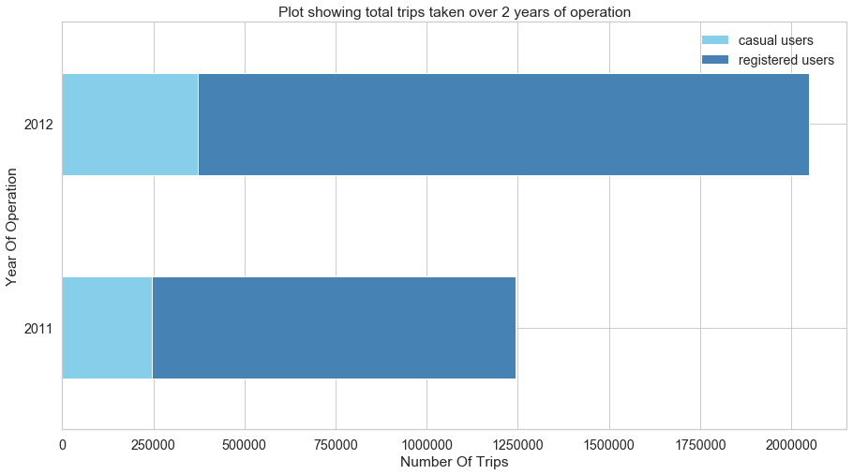
Year-Over-Year Growth
Total 1.25 million trips and 2 million trips taken in 2011 & 2012, respectively – a 60% growth over a year
Trips taken by registered users grew by 62.5% (from 1mn to 1.625mn trips)
Avg trips per day grew by ~57% (from ~3.5k trips a day to ~5.5k/day)

Slide 3
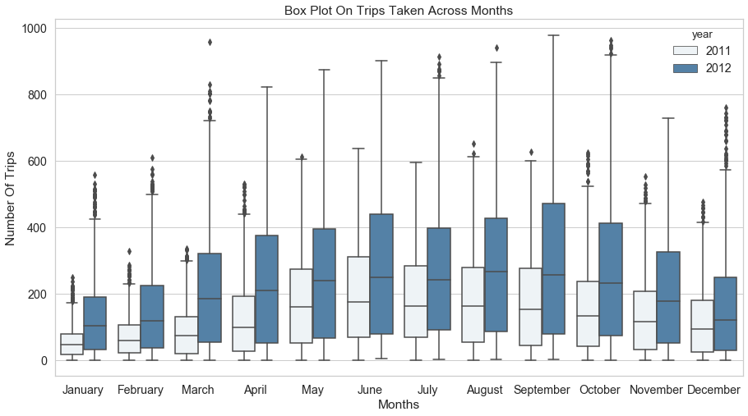
Behavior Of Rentals Over Months
The median of the boxplots over the months across years is increasing
The rentals show increasing trends from Jan to June months, and then start to decrease
The pattern repeats in both the years clearly showing the cyclic behavior of the rentals
The months of Summer season show the pick in demand
Sluggish demand is seen in the months Winter season

Slide 4
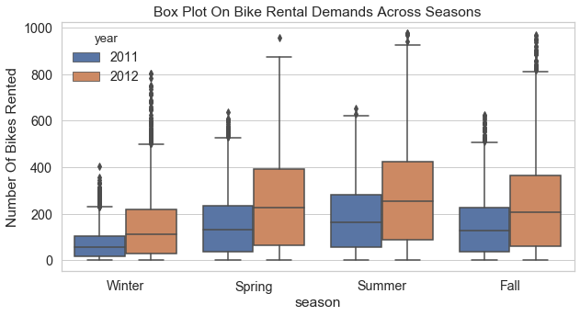
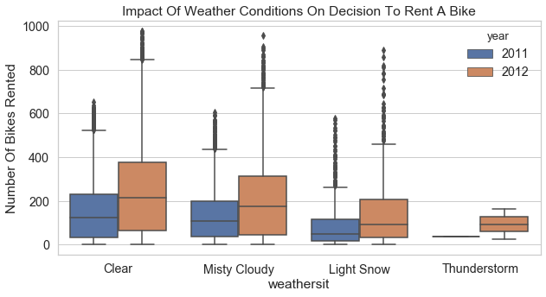
Behavior Of Rentals Over Seasons
The highest rental demands is seen during the Summer season, followed by Spring and Fall
Users do not prefer to ride during the Winter season maybe due to unfavorable conditions such as less visibility, light snow and low temperatures
An overlap between the season and the weather conditions indicate that the bikers prefer clear/slightly cloudy weather the most which is seen during Summer, Spring and Fall
The pattern in rental demand is cyclic in nature – repeating across both the years

Slide 5
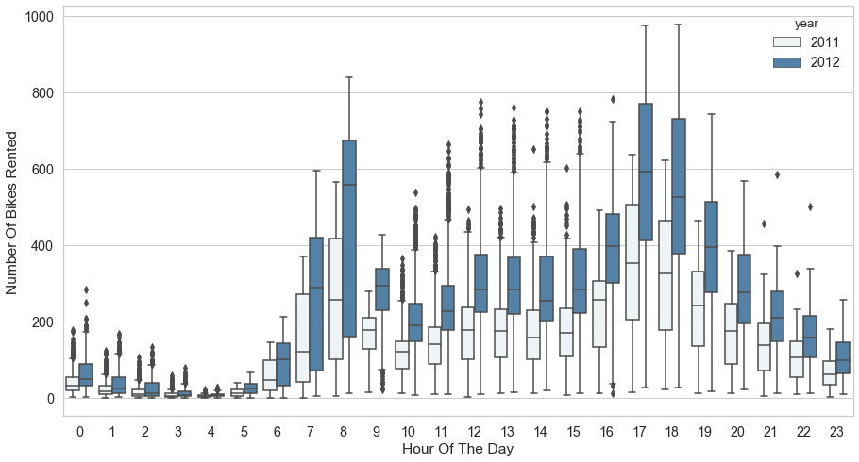
Behavior Of Rentals Over Hours Of The Day
Rental demand picks between 7am-8am and 5pm-6pm
Can be attributed to the regular office workers which prefer bicycle as their transportation option
Demand is almost relatively constant between the pick hours

Slide 6
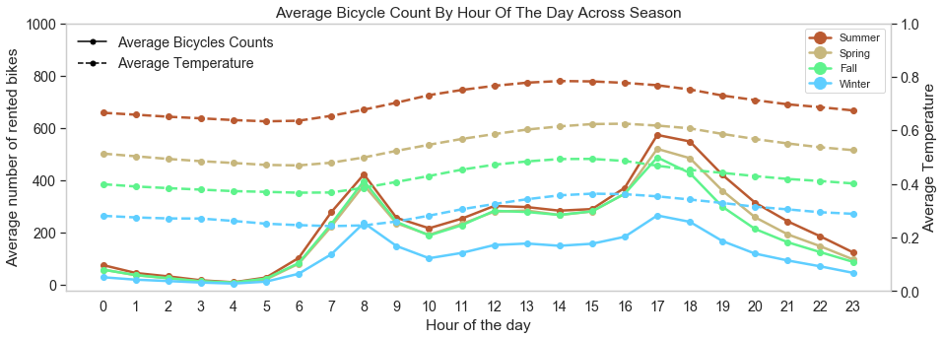
Impact Of Temperature On Rental Demand
Positive correlation between average temperature and average demand
Average temperature and demand are highest during Summer season
Overlap in average demand across Summer, Spring and Fall seasons however average temperature are different
Temperature is not the only deciding factor behind renting a bike – other factors such as humidity, wind speed, feel-like temp might influence the decision to rent a bike

Slide 7
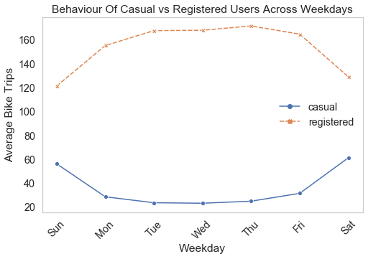
Behavior Of Users Across Weekdays
Registered users demands are high on working days (Monday through Friday) while the casual users demands are high on weekends
Both set of users suggest different set of puposes
Registered users might be regular office workers, students for
Casual users might be tourists, fitness enthusiasts who wants to explore the city

Slide 8
Conclusion
The Bike Sharing Program overall has seen a good response and growth by the citizens. The trend in the incresing demands suggest that the citizens are considering renting the bike as a serious alternative transportation option in their daily lives.
The trends and patterns of demands clearly are cyclic in nature. The demands pick during Summer, stay relative steady during Spring and Fall, considerably decrease during the Winter season. This pattern repeats the next year.
Temperature alone is not a deciding factor behind rental decision though there is a correlation. The other weather conditions might factor in too.
The purpose of the casual and registered users are different. Registered users opt for bikes to carry on in their routine lives so their sources and destinations can also be predicted, where as the casual users hire a bike to roam around the city - to explore its nooks and corners.

